Slide 2
Inductive Bible
Study Method

Slide 3
Welcome back to IBSM
Bite 02

Slide 4
Lesson Objectives
Upon completion of today’s lesson, you will be able to:
Define the process of Bible Study
Explain the three steps of IBSM
Understand the importance of knowing how to read

Slide 5

Bible study is . . .
methodicalness

Slide 6
Method is Methodicalness…
Involves:
Take certain steps
In certain order
To bring about certain results
Notes:
Methodical / Systematic – involves taking certain steps in a certain order to bring about a certain result. Not just any steps, not just any order, not just any result:

Slide 7
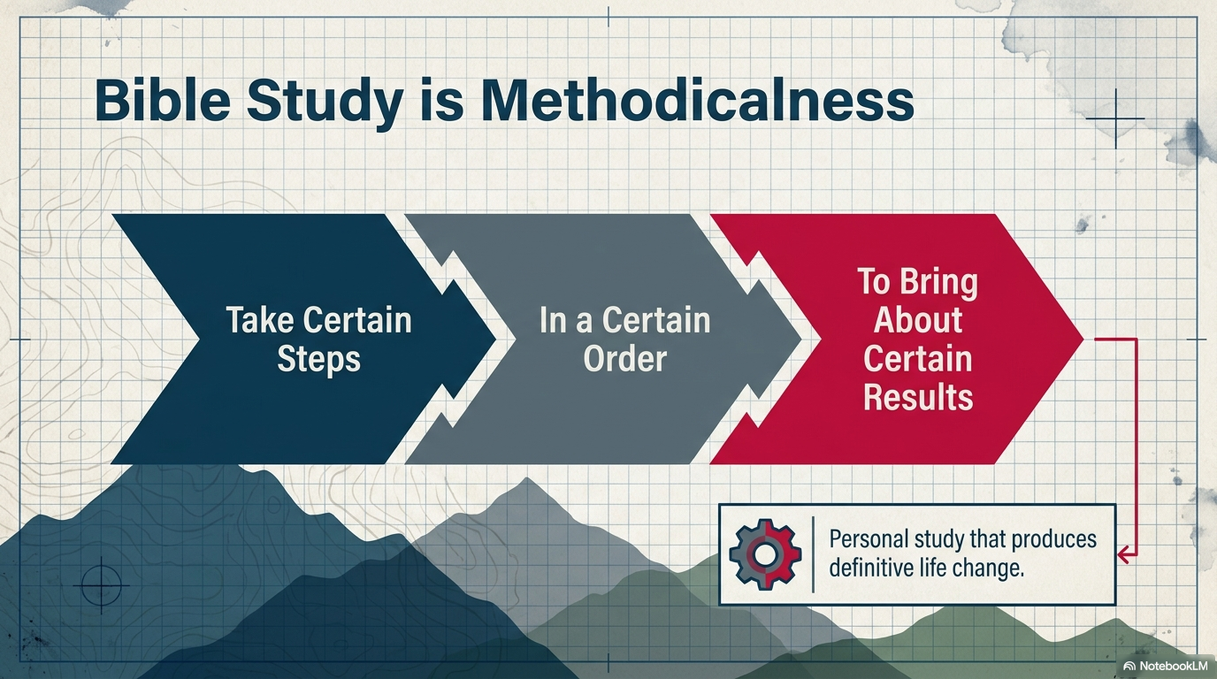

Slide 8
The end product
Personal study of the Scriptures
Study that produces life change

Slide 9
The process
Observation
Interpretation
Application

Slide 10
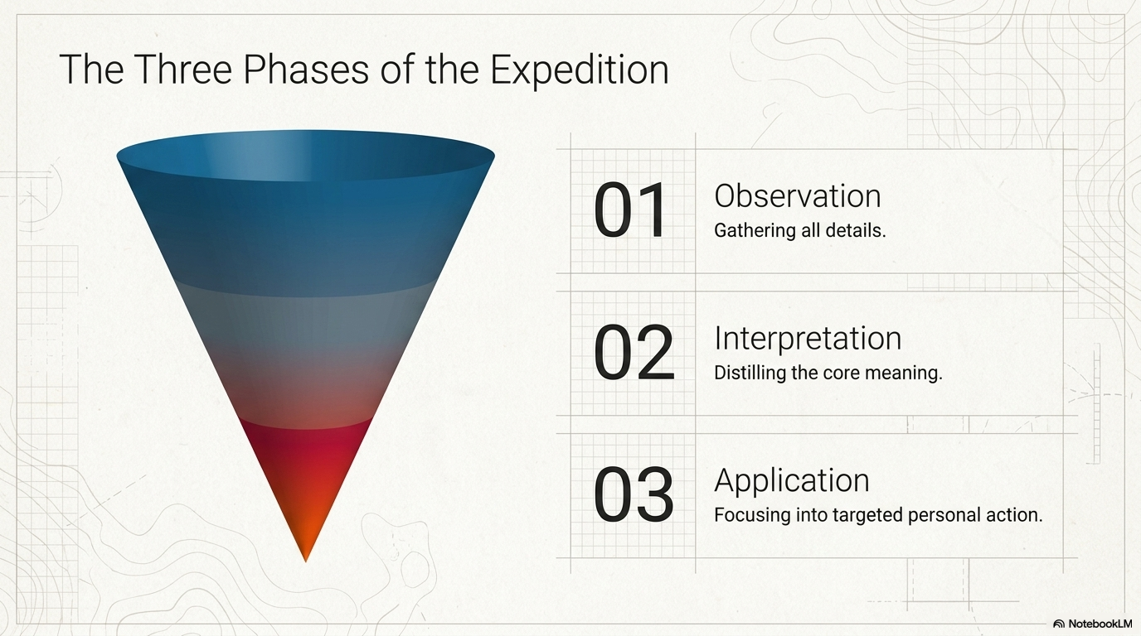

Slide 11
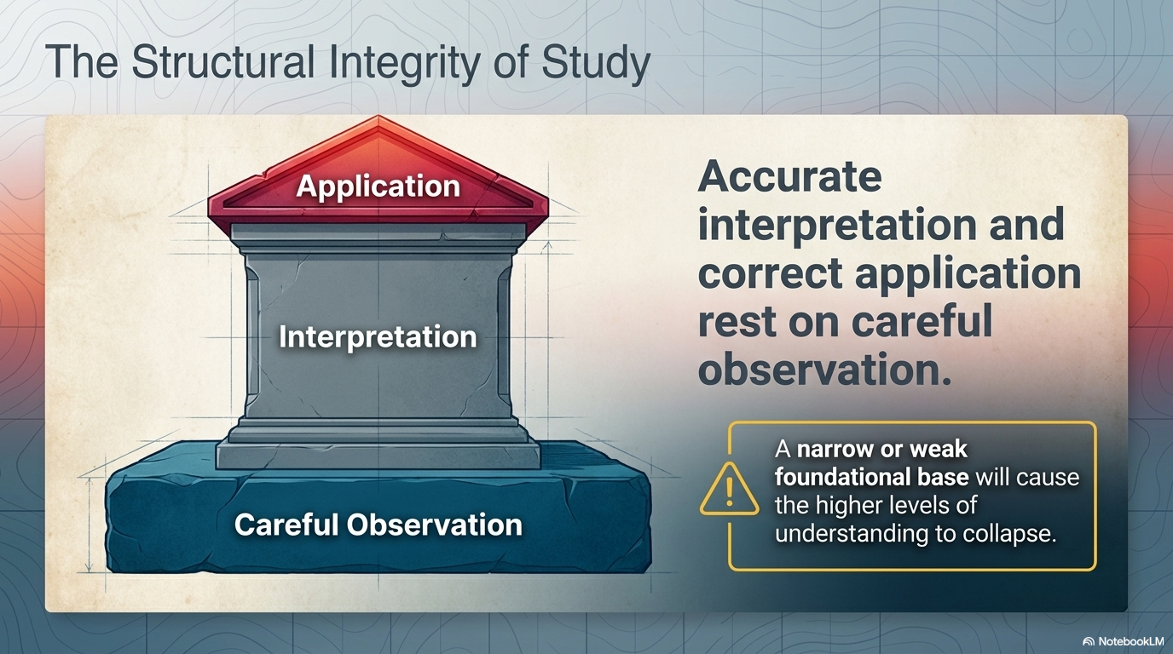

Slide 12

I. Observation
What?
What do I see?

Slide 13
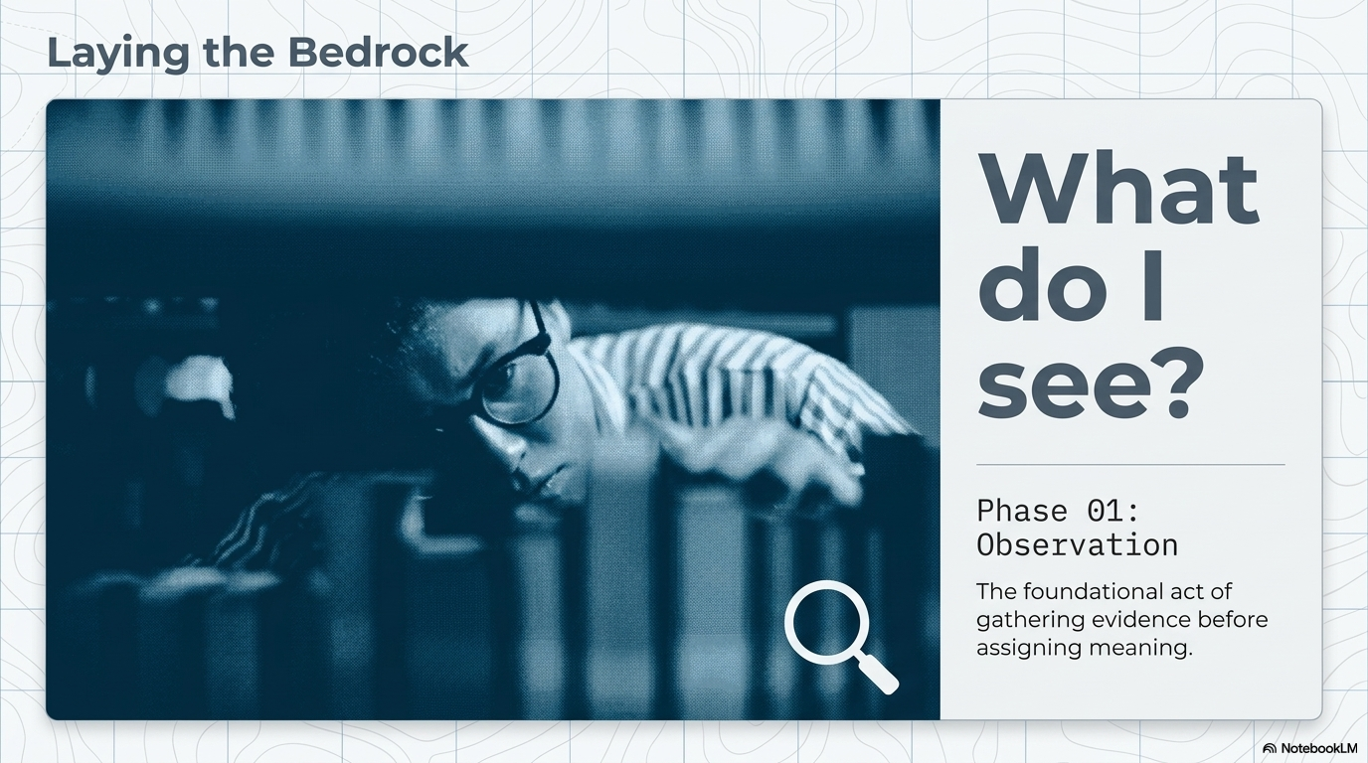

Slide 14

I. Observation
II. Interpretation
What does it mean?

Slide 15
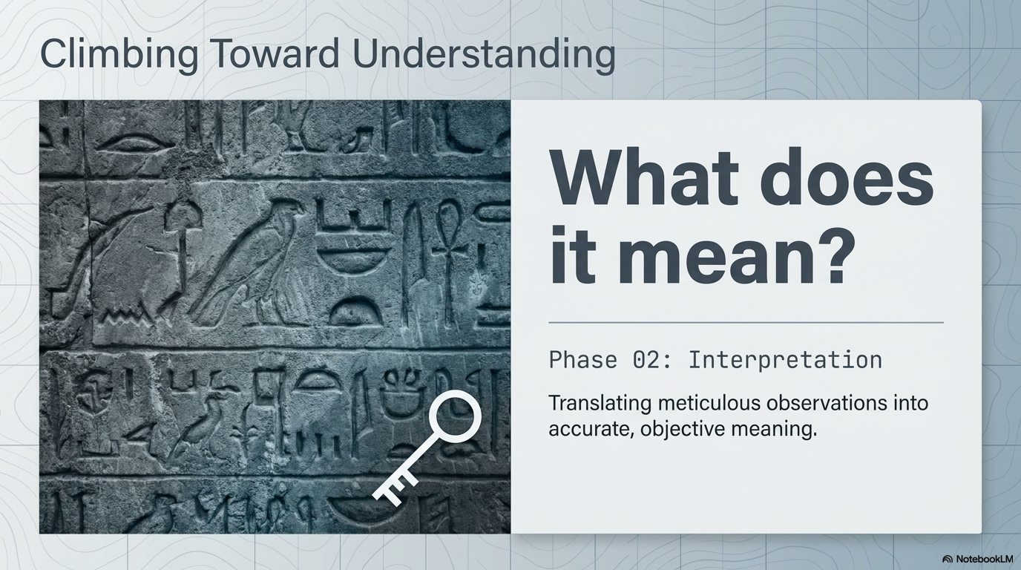

Slide 16

I. Observation
II. Interpretation
III. Application
What does it mean to me?

Slide 19
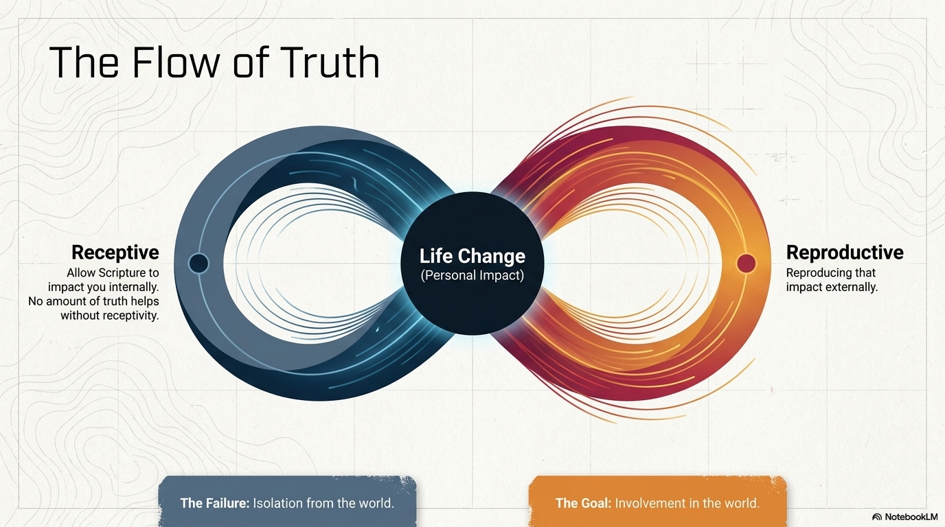

Slide 20

Review
#1 Observation
#2 Interpretation
#3 Application

Slide 21
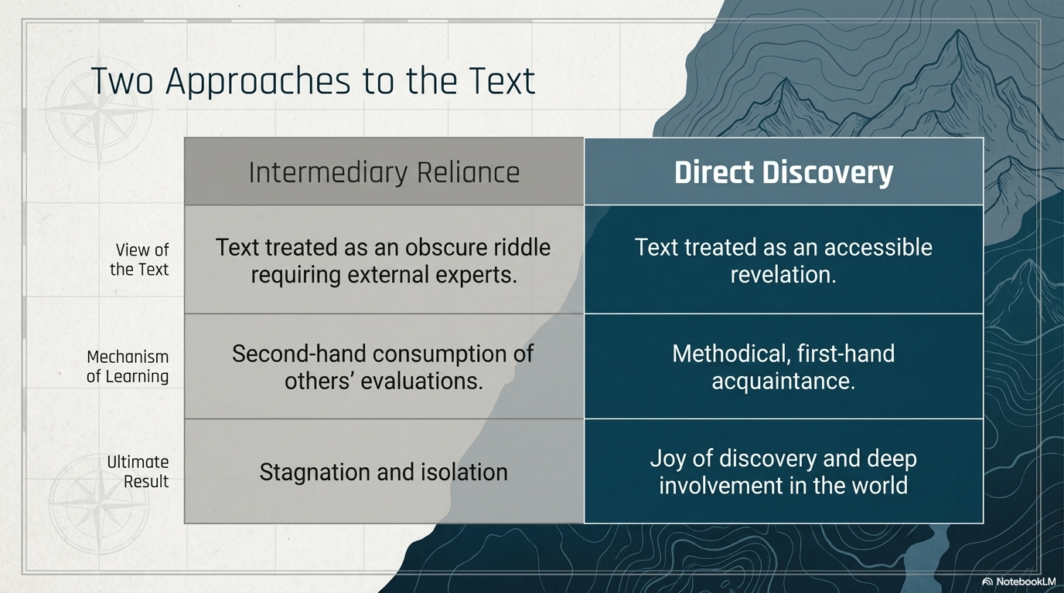

Slide 22


Slide 23
Three Steps
What do I see?
OBSERVATION
Inductive Bible Study Method
APPLICATION
INTERPRETATION
How does it work?
What does it mean to me?
What does it mean??
Notes:
Use body gesture to help you remember:
Observation – multitude – a large number of things you should pay attention to. The better you observe, the more you’ll notice. The more you notice, they better you are in understanding the meaning of a passage.
Interpretation – one – when the author wrote a particular passage, he had one intended meaning in mind. In other words, he does not leave it to his audience to come up with whatever meaning. Rather, he had a specific purpose or meaning in mind. Kind of like The Boy who Cried Wolf story. The author had a particular message in mind when he wrote/told the story.
Application - many

Slide 24

Accurate interpretation and correct application rest on careful observation

Slide 25
Bible study is . . .
methodicalness

Slide 26
Bible study is . . .
methodicalness with a view to becoming receptive and reproductive

Slide 27
Receptive and Reproductive
No amount of truth will help you unless you are receptive to it.
Before you can make an impact on the society, you must first allow Scripture to impact you,
Once you have been impacted, then you should reproduce such impact on others. (Reproductive)
Notes:
Notice the importance of proclamation. It’s not enough to study and enjoy the scripture on your own. You are called to proclaim it. Remember Great Commission,
Therefore go and make disciples of all nations, baptizing them in the name of the Father and of the Son and of the Holy Spirit, and teaching them to obey everything I have commanded you.

Slide 28
Receptive and Reproductive
Involvement in the world.
Isolation from the world
Notes:
Notice the importance of proclamation. It’s not enough to study and enjoy the scripture on your own. You are called to proclaim it. Remember Great Commission,
Therefore go and make disciples of all nations, baptizing them in the name of the Father and of the Son and of the Holy Spirit, and teaching them to obey everything I have commanded you.

Slide 29
Bible study is . . .
methodicalness with a view to becoming receptive and reproductive by means of first-hand acquaintance with the Word.

Slide 30
First Hand Acquaintance
Some Reasons:
It will enable you to think for yourself (Bible was not given as a riddle, but as a revelation).
It will allow you to evaluate the thoughts of others. NOTE: “Sola Scriptura” was a key thrust during the Reformation.
It will give you joy of personal discovery.
It will enable you to “communicate” with the author directly instead of through an intermediary, so you can deepen your love for the Lord.
Notes:
- Bible is your primary source
- your personally explore the Scripture apart from conclusions drawn by others. (Researches have shown that you learn more and remember better they things you discovered for yourself!)
you consult the commentaries, books, tapes, sermons only AFTER you have made your own thorough study of the text
It will enable you to think for yourself (Bible was not given as a riddle, but as a revelation).
It will allow you to evaluate the thoughts of others. “Sola Scriptura” was a key thrust during the Reformation.
It will give you joy of personal discovery.
It will enable you to “communicate” with the author instead of through an intermediary. That’ll help you fall in love with the Lord (imagine communicating with your wife through a intermediary)

Slide 31
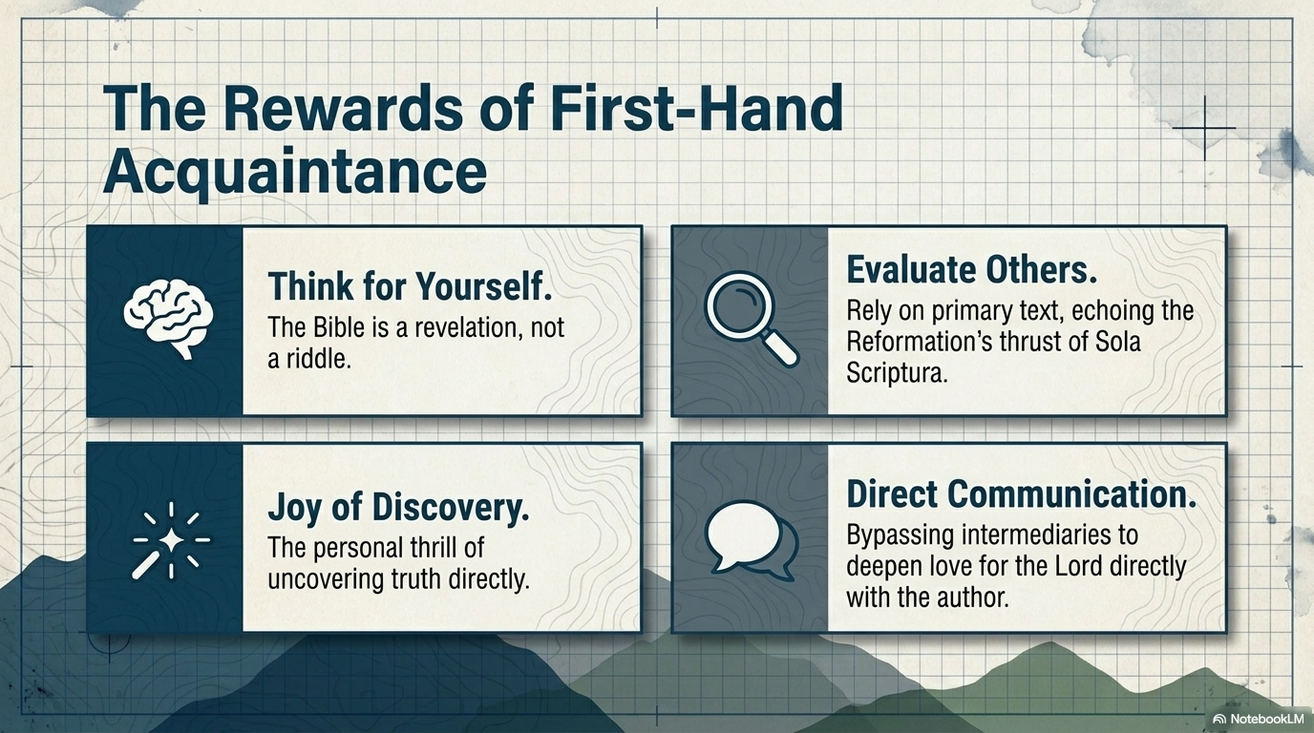

Slide 32

Start by learning how to observe…more specifically, how to read!

Slide 33
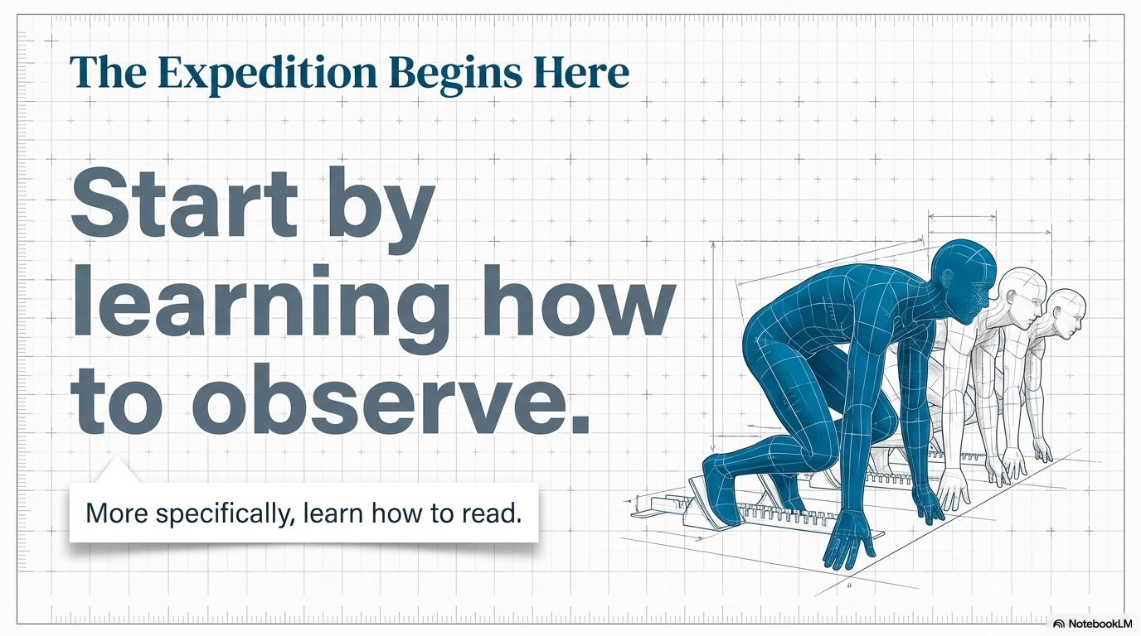

Slide 34


